Slide 1
Used Cars Price Prediction Project
A presentation by Arun Joshva Stephenson (Internship 29)

Slide 2
Table of contents
Introduction
Problem statement
Understanding the problem
Analysis of literature – used car pricing and benefits
Data analysis and model building
EDA steps
Visualizations and data analysis
Assumptions
Model building
Hyperparameter tuning and testing final model
Saving the model and final predictions
Conclusion

Slide 3
Introduction
Predicting car prices is an important and fascinating problem. Predicting a car's resale value is a difficult task. It is common knowledge that the value of used cars is determined by a variety of factors.
The car's age, make (model), origin (the manufacturer's original location), mileage (the number of kilometers it has travelled), and horsepower are usually the most essential considerations (amount of power that an engine produces)
Consumer reviews, its physical state, whether it is automatic or manual transmission, whether it belonged to an individual or a company, and other options such as air conditioning, sound system, and power steering may all influence the price of a used car.

Slide 4
Problem statement
With the covid 19 impact in the market, we have seen lot of changes in the car market. Now some cars are in demand hence making them costly and some are not in demand hence cheaper. One of our clients works with small traders, who sell used cars. With the change in market due to covid 19 impact, our client is facing problems with their previous car price valuation machine learning models. So, they are looking for new machine learning models from new data. We have to make car price valuation model.
This project's main goal is to anticipate the price of a used car based on a variety of factors. Machine Learning is a rapidly evolving field of technology with vast capabilities and applications in work automation. As a result, we'll use a machine learning model to forecast and analyse car selling prices. This type of arrangement is beneficial to a large number of people. This model will estimate the car's selling price based on several aspects and will assist the client in determining the price of used autos.

Slide 5
Understanding the problem
Car Price Prediction is a fascinating machine learning problem because there are numerous elements that influence the price of a used car. By deploying machine learning models, we are attempting to assist the client that works with small traders who sell used automobiles in understanding the price of used cars. These models would assist clients/sellers in comprehending the used automobile industry and, as a result, selling used cars in the market.
We know it's a regression problem because our target variable "Price" is continuous, so we'll need to create regression algorithms to forecast the price of used automobiles based on the problem statement.

Slide 6
Analysis of literature – used cars
A used car, often known as a pre-owned vehicle or a used car, is a vehicle that has previously been owned by one or more retailers. Rental car firms, independent car dealers, buy here pay here dealerships, leasing offices, auctions, and private party sales are just few of the places where used cars are sold. Typically, used automobile pricing studies produce three types of pricing data.
Retail or dealer price
Wholesale pricing or dealer trade-in price
Price for a private party

Slide 7
Analysis of literature - benefits
Save money
Access to premium car features available only in expensive models
Lower insurances
Advantages associated with depreciation
Vehicle history reports
Field-tested vehicle at lower costs
Rich aftermarket communities for used cars
No worry of customizations on a new vehicle

Slide 8
Analysis of literature - importance
In case of a used car, depreciation has already occurred several times, thereby, slower decrease in value
Limited hidden charges, costs etc. associated with the purchase, except for documentation of transfer of ownership, etc.
Extra fittings, which are always pricey when put in a new automobile, do not need to be added to a used car. With a little price, you can add extra fittings of your choice to a secondhand car. This will assist you in saving money.
Pre-owned vehicles are inspected for damage and repaired. After a thorough inspection, a certificate is issued certifying that the vehicle is of good condition.

Slide 9
Data analysis and model building
Importing necessary libraries
Loading the dataset
Checking for null values, data types of variables and dataset description
Visualizations (EDA) – Univariate, Bivariate and Multivariate
Establishing correlations
Data pre-processing
Removing outliers and skewness
Encoding categorical data
Splitting features and label
Scaling the data
Finding out the best random state
Building the prediction model and testing the results of various regressors
Hyper parameter tuning
Saving the model and predicting the prices

Slide 10
EDA steps
Checks for statistical information like data type, shape of dataframe, etc.
Distribution of data using univariate analysis
Establishing relationship between key features and the label (price)
Identifying correlations among the features and the label
Skewness checks
Outlier checks
Encoding of categorical data, splitting the features and label, and applying standard scaler

Slide 11
Visualizations and data analysis
Univariate analysis: investigated the distribution of skewness using distplots for numerical features and count plots for categorical data because of the presence of both numerical and categorical columns
Bivariate analysis: utilized a variety of plotting approaches to investigate the relationship between features and the label using catplots and discovered continuous variables that had a strong relationship with the label “Price”
Multivariate analysis: checked the correlation between the numerical features and Price of the vehicle using a heatmap, which revealed both positive and negative correlations between the label and numerical features

Slide 12
Results: Univariate analysis
Price is not normally distributed across the dataset. Most cars available for sale on the website are of the manual transmission. Cars with petrol and diesel as fuel type were readily available for sale, with comparatively lower numbers for both, CNG and LPG.

Slide 13
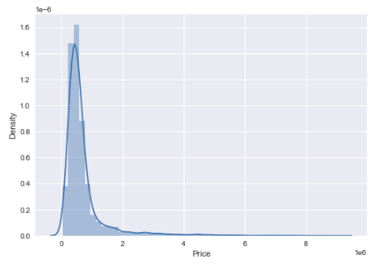
Univariate analysis
Distribution of price data in the dataset

Slide 14
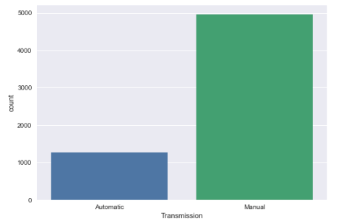
Univariate analysis
Distribution of used cars in the dataset based on the transmission type of the vehicle

Slide 15
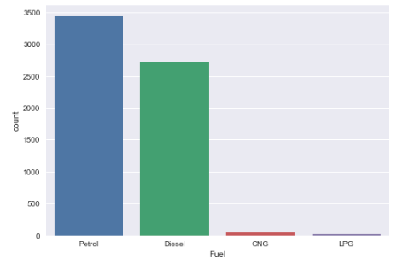
Univariate analysis
Distribution of used cars in the dataset based on the fuel type of the vehicle

Slide 16
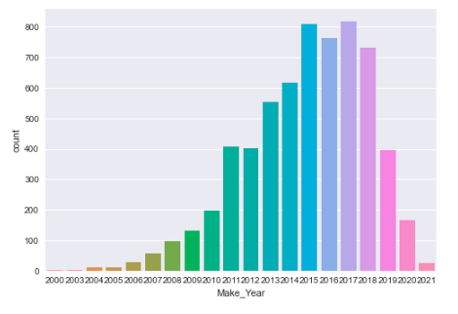
Univariate analysis
Distribution of used cars in the dataset based on the year of manufacture of the vehicle on the registration documents

Slide 17
Results: Bivariate analysis
Price of automatic transmission cars is higher than that of manual transmission cars. Cars running on diesel were more expensive than any other fuel type, followed by those running on petrol, CNG and LPG respectively. From the third plot, it is evident that prices were consistently growing for models manufactured till 2019, post which, the resale prices declined drastically, leading to a conclusion that the global pandemic left consumers with wiped out disposable incomes and savings, and cars purchased during the pandemic were possibly being sold under financial distress. To test this hypothesis, a more detailed research / study may be required.

Slide 18
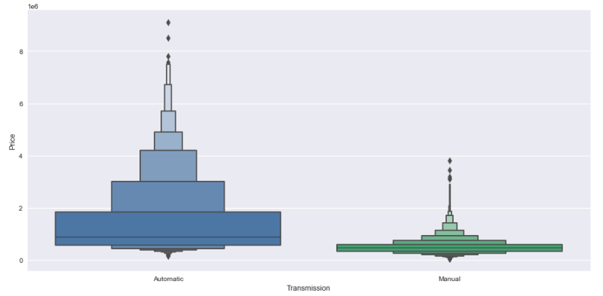
Bivariate analysis
Relationship between price and transmission of vehicle

Slide 19
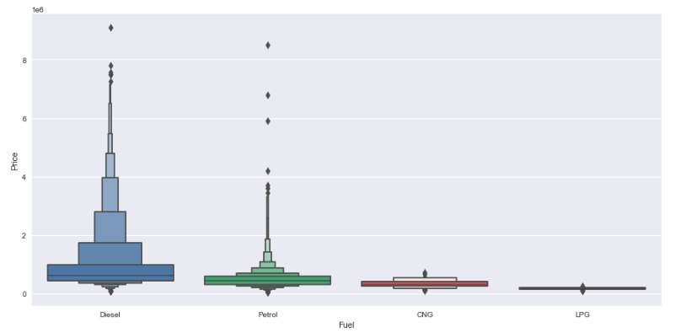
Bivariate analysis
Relationship between price and fuel type of vehicle

Slide 20
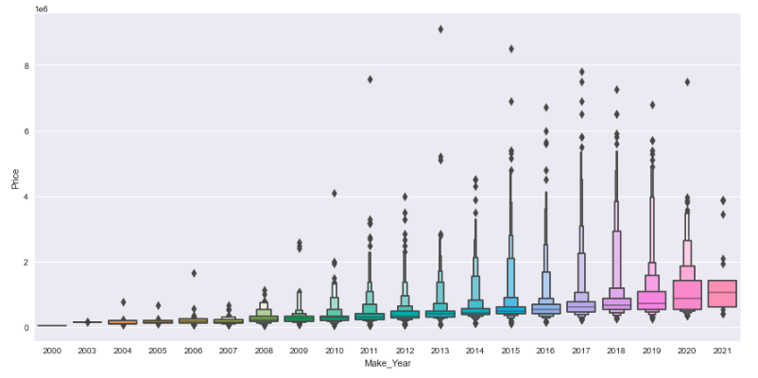
Bivariate analysis
Relationship between price and year of make of vehicle

Slide 21
Results: Multivariate analysis
A correlation matrix is essentially a table that shows the relationship between two or more variables. The measure works best with variables that have a linear relationship with one another. A heatmap can be used to visualize how well the data fits together.
Findings: Engine and Price were highly correlated, whereas, surprisingly, number of owners and price had the least correlation.

Slide 22
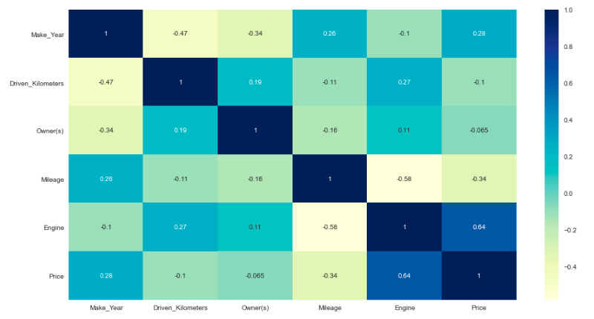
Multivariate analysis
Understanding the linear relationship between each of the features, and of the features with the target variable (price)

Slide 23
Assumptions
The problem statement identifies sale and purchase of used cars as a regression problem, which the directed the data extraction and scraping from the web (using cardekho.com)
Several features appear to have a linear relationship with the target variable (price), which leads to the assumption that such features influence the price of the used car, which may not necessarily be true. Such features have been used in the building of the prediction model
The limited information of variables extracted from the website leads to the assumption that the buyer and seller operate on similar assumptions dictating the price of the used car. However, a buyer might consider variables other than what a seller might deem important while deciding the price of the vehicle, thereby creating a potential gap between the actual and perceived value of a used car

Slide 24
Model building
Scraped over 6,462 records and grabbed data for various cities across India, collecting information on various car attributes, and saving the information in excel format.
The final dataset, post data cleaning has 6,224 rows and 11 columns, with the target variable "Price" being one of them.
Input data was cleaned and scaled before feeding it into the machine learning models.
Looked for the optimal random state for the Regression model.
Evaluation metrics and numerous regression models were created and tested for their efficacy.
We needed to forecast the price of used cars for this project. The target variable in this dataset is Car Price, which means our target column is continuous, making this a regression problem. I forecasted the car price using a variety of regression models. After a series of tests, I determined that Random Forests is the best approach for creating our final model since it has a high R2 score and lowest difference R2 score and cross-validation score of all the algorithms tested.

Slide 25
Model building
After pre-processing and data cleaning, I was left with 10 columns, including the target variable, and I used these independent features for model development and prediction. The following are the algorithms that were utilized to train the data:
Random Forest Regressor
K-Neighbors Regressor
Decision Tree Regressor
Lasso
Ridge
We tested on 5 regression algorithms after choosing the random state with range 1 to 300 and used linear regression to find the best random state.

Slide 26
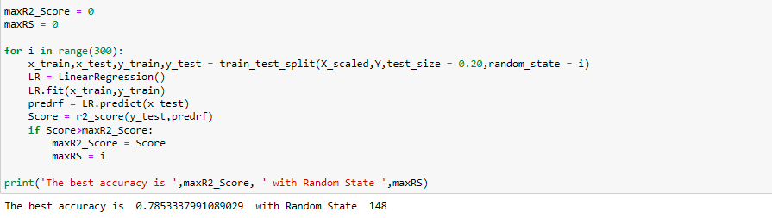
Finding the best random state
Model building

Slide 27
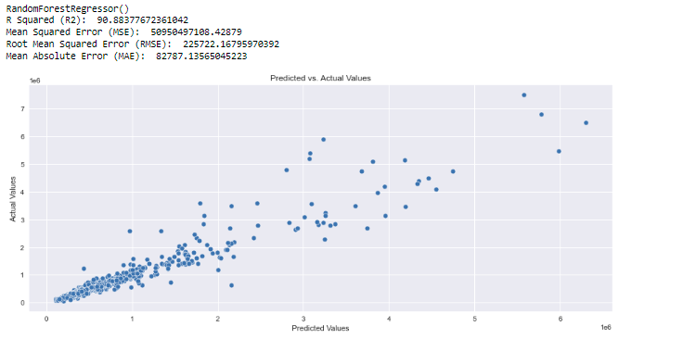
Random Forest Regressor
Model building

Slide 28
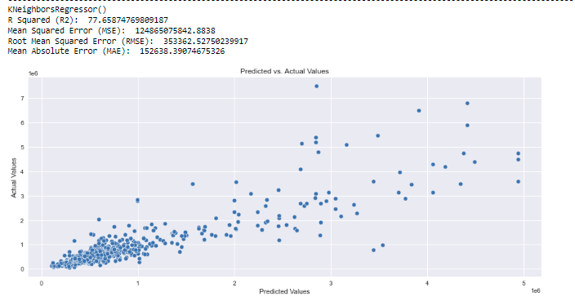
K-Neighbors Regressor
Model building

Slide 29
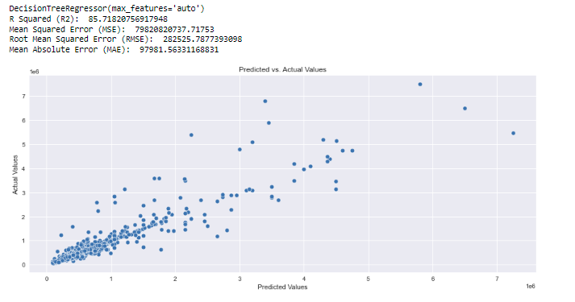
Decision Tree Regressor
Model building

Slide 30
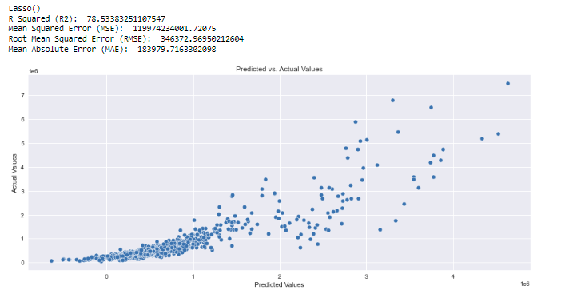
Lasso
Model building

Slide 31
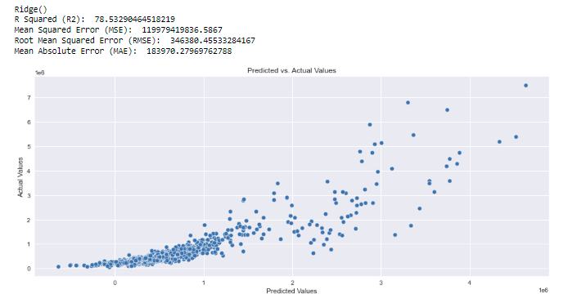
Ridge
Model building

Slide 32
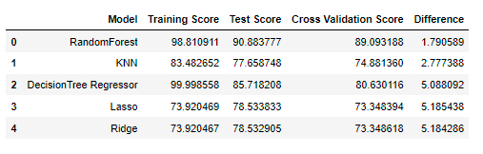
Summary of results
Model building

Slide 33
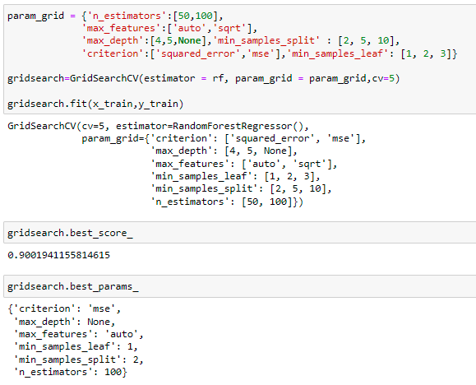
Hyperparameter tuning and testing final model

Slide 34
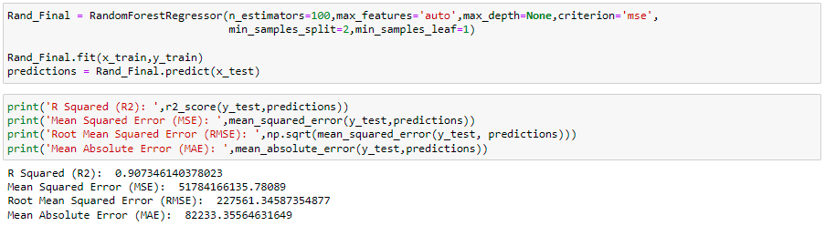
Hyperparameter tuning and testing final model

Slide 35
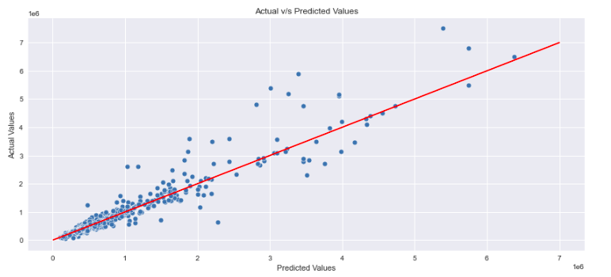
Hyperparameter tuning and testing final model

Slide 36
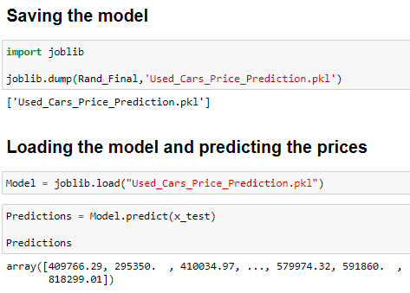
Saving the model and final predictions

Slide 37
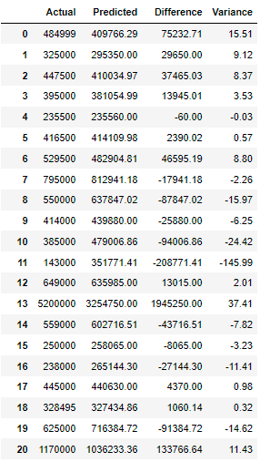
Saving the model and final predictions
Dataframe of final prediction and their comparison with actual prices of the used cars data extracted from CarDekho.com

Slide 38
Conclusion
We created multiple regression models in this research to forecast the selling price of cars based on some of the cars' characteristics. We compared and assessed each model to see which one performed the best. We also investigated how various models order the attributes in terms of relevance. We followed the data science process in this study, starting with gathering data, cleaning, and pre-processing it, then examining the data and developing models, and finally evaluating the results.
The model can be utilized with datasets that cover many areas if they have the same properties.
Accomplished our goal by predicting the sale price of used cars and developing a car price evaluation model that could assist clients in understanding the future price of used cars.

Slide 39
Conclusion
We learned throughout the entire investigation that continuous numerical variables had a strong positive linear relationship with the label "Car Price." We discovered that automobiles with automatic gear transmission, cars utilising petrol and diesel as fuels have high sale prices by comparing car prices and categorical characteristics.
When comparing continuous numerical variables to Car Price, we discovered that automobiles with good mileage, engine displacement, and less running in kilometers had a solid linear relationship with the price, implying that cars with these features sell for a high price. We identified and removed the outliers, as well as skewness. Looking at the heat map, I identified features that were highly correlated, and scaled the data to compensate for the data bias.

Slide 40
Thank You

